Slide 1
WORLD ENVIRONMENT DAY
5 JUNE 2022
“Cherish the natural world because you’re a part of it and you depend on it.” David Attenborough
World Environment Day began in 1974 and is the biggest international day to act and raise awareness for our environment. 150 countries are participating and Sweden is the host country in 2022. This year the theme is ‘Only One Earth’ focusing on living sustainably in harmony with nature. We only have one earth so let’s take care of it!
2022 is a historic milestone as it marks 50 years since the 1972 UN Conference on the Human Environment, which is considered to be the first international meeting on the environment. This conference inspired environmental agencies and ministries around the world to put global agreements into place to protect our natural environment. This paved the way for the Sustainable Development Goals where the goals of poverty alleviation and environmental protection were linked. World Environment Day addresses 11 of these 17 goals highlighting the importance of integral ecology.
World Environment Day encompasses almost everything to do with our common home; climate change, biodiversity, sustainability, water, air quality etc.
Did you know?
Recycling one aluminum can save enough energy to run a TV for three hours. An aluminum can, can be recycled ‘over and over’ forever! How good is that? Source
Uluru. Source
Action!
Raise awareness and organise a special week/day to celebrate World Environment Day e.g., Rubbish Free week, research an ecological justice issue, create a display or diorama to share with parents at an expo type event.
Find a Landcare group activity to join.
Use a reusable drink bottle, pick up some extra litter, walk, ride, scoot or use public transport to get to your destination.
Refuse to buy items that have excess packaging, recycle as much as you can.
Make a pledge to not buy anything new unless it is essential, repair and re-use an item.
Grow some fruit and vegetables, give the excess to your neighbours.
Design, create and display a poster to encourage a particular environmental behaviour.
Use social media to raise awareness about protecting our common home.

Slide 2
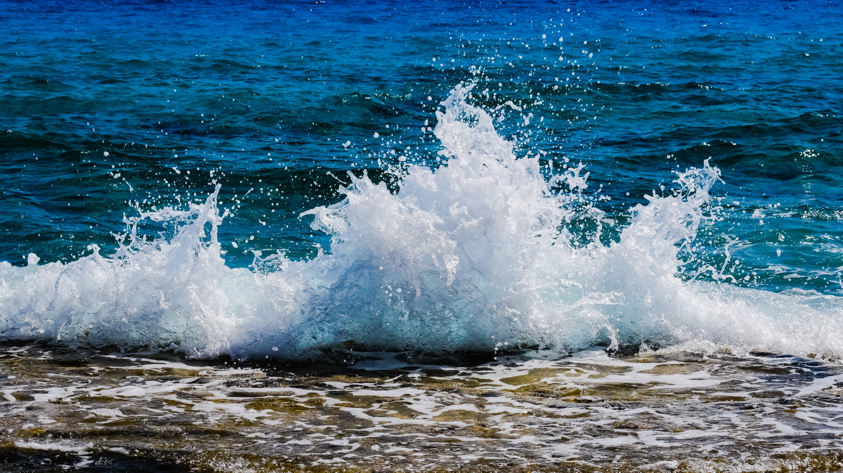
WORLD ENVIRONMENT DAY
5 JUNE 2022
Turn your school ground/home or parish garden into an ecosystem!
Could you plant some indigenous plants in your school garden to provide food and shelter for our Australian animals?
Provide a water source such as a pond or bird bath for animals and small critters.
Solve a drainage problem by creating a frog bog.
Reduce your work load by leaving leaf litter, sticks, hollow logs etc. lying around in your garden as they are habitat for our animals.
Suggested Activities
Search for animals in your school grounds to check the biodiversity level. Use iNaturalistAU to identify what you find.
Make a pond dipping net, enjoy a walk to your local creek and go fishing! Use a white tray with water in the bottom to see what you might have caught. Contact your local Waterwatch organisation to learn more.
Connect with nature by meditating or saying a prayer outdoors.
Research a plant or animal species that is endangered. Create a piece of Art to display to educate others and raise awareness.
Make extra efforts to compost, recycle, use less energy and water
Resources: Primary and Secondary
Care for our Common Home 4 min video on caring for each other and creation
Twinkl World Environment Day resources
Water Quiz
Food Quiz
Body of Water Source
Secondary
Caring for Creation – a series of ‘see, Judge, Act’ lessons on our common home
A Laudato Si’ Reflection and Laudato Si’ Reflection Cards
Test your knowledge on our environment by completing the triple planetary crisis quiz.
ClimateHero Carbon Calculator (students will need some information from home)
Primary
Caring for Creation – a series of ‘see, Judge, Act’ lessons on our common home
Laudato Si’ Week activities
Choose a mission to save the planet with Genus
Play some footpath games or go on a Nature walk

